Slide 1

REGIONAL ENTERPRISE SUPPORT CENTRE -PLEVEN
RESC Pleven,
Bulgaria

Slide 2
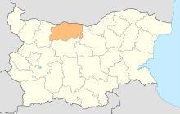
Who we are?
The Regional Enterprise Support Centre is a non-profit organisation, registered on November 23, 1998, and is located in Pleven, Bulgaria.

Slide 3
The founder members are:
the Bulgarian-German Vocational Training Centre in Pleven;
the regional branches of the Bulgarian Chamber of Commerce
and
the Bulgarian Chamber of Construction.
Members are also the Branch Business Chamber, “Znanie” Union – Pleven, municipality Iskar and individuals.

Slide 4
What are our objectives?
Our strategic goal is to contribute to the sustainable economic and social development of the region of Pleven by promoting and supporting:
the development of SMEs with a focus on young people;
the development of a favorable entrepreneurial culture
and
active employment measures.

Slide 5
We offer the following service portfolio:
I. Support measures:
1. Competence Assessment.
2. Using the Rickter model for assessment and soft skills development.
II. Offers for assistance:
Project work with young people.
Experience as a host organization.
Training / consulting measures.

Slide 6
Some projects:
Project “Creating a joint labour market through mobility and training services in Olt-Pleven area”, Cross Border Cooperation Programme Bulgaria-Romania, 2011-2013, extended until 2015. Target groups: young unemployed people.
Project “European Centre for youth employment and entrepreneurship”, in frame of operational programme „Human resources development”, 2013-2014, as Partner of Association “Development of Personality and Human Communities” Pleven and Rickter company, UK. Target groups: young unemployed people.

Slide 7
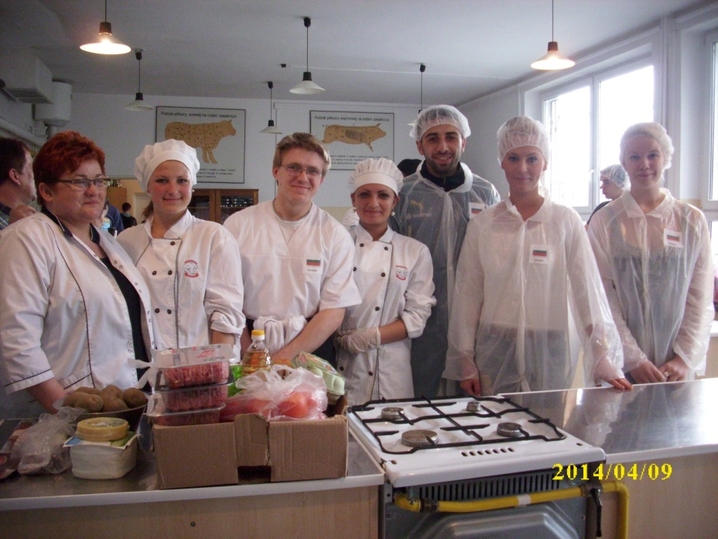
Some projects:
Project „Network for Mobility in Eastern and South- Eastern European Countries for Disadvantaged Apprentices – Easy Mobil“ , in Frame of LLP, Leonardo da Vinci, Partnership, 2012-2014. Target groups: young people in vocational education and students with special needs.

Slide 8
Some projects:
Project “Competence Assessment - an innovative instrument for career planning and increasing of employability of Roma - Kompass”, in Frame of LLP, Leonardo da Vinci, Transfer of innovation, 2012-2014, as Partner of Educational Institute PSCHERER non-profit plc, Germany and partners from DE, HU, RO and FR. Target groups: Roma.

Slide 9
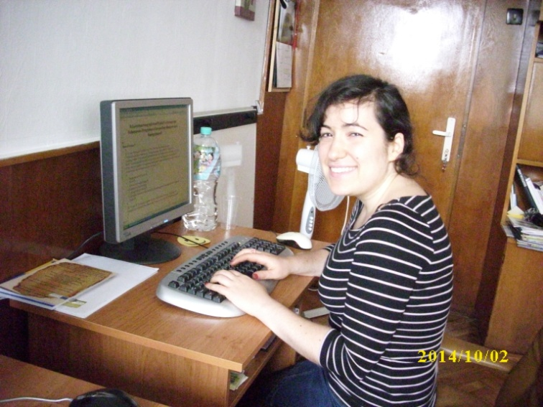
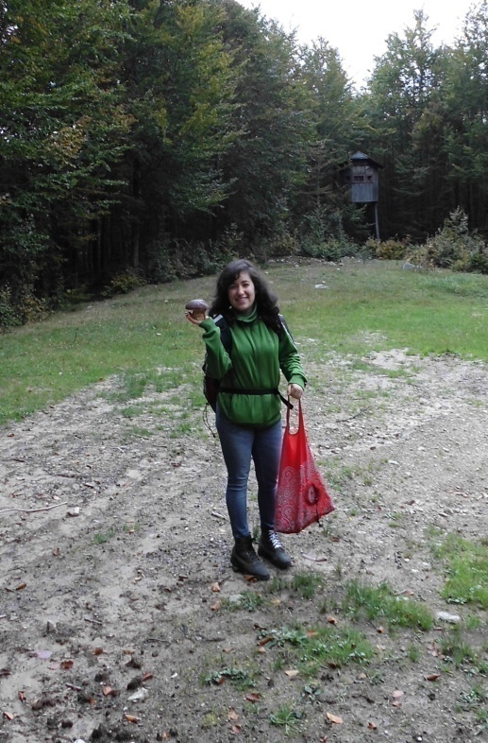
Some projects:
RESC Pleven is a host organization for young people with special needs.
Sandy from Germany

Slide 10
PLEVEN
10

Slide 11
Thank you for your attention!
www.resc-pleven.org
Penka Spasova

