Slide 1
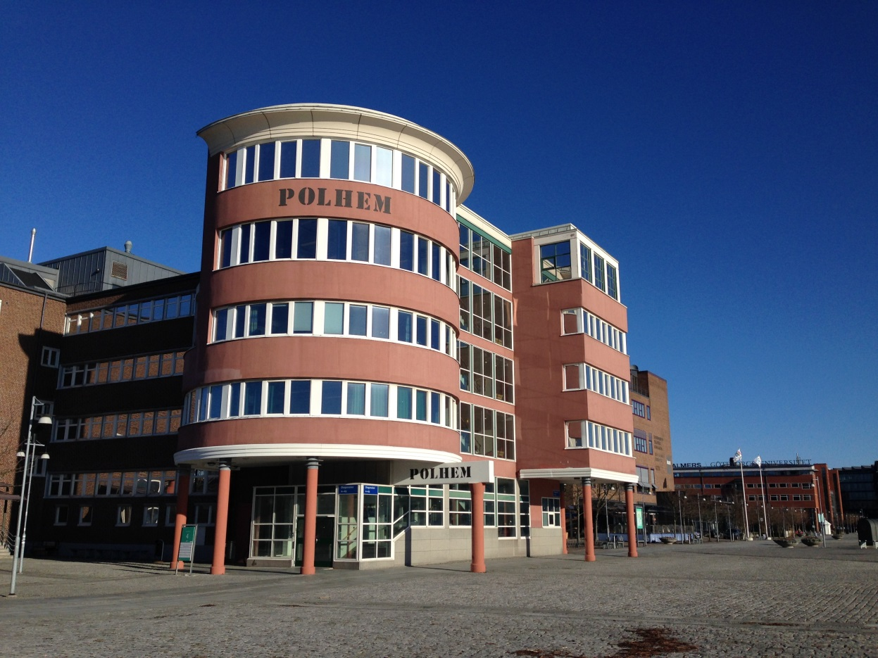
Polhemsgymnasiet in Göteborg

Slide 2
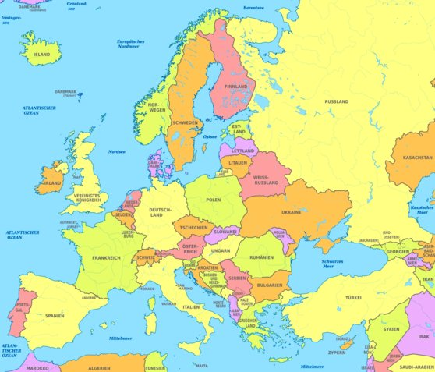
Polhemsgymnasiet is an upper secondary school which is situated in a very dynamic area in Göteborg, “Lindholmen Science Centre”.
We are on the northern banks of the Göta river in a previous shipbuilding area in the city centre on the west coast of Sweden.

Slide 3
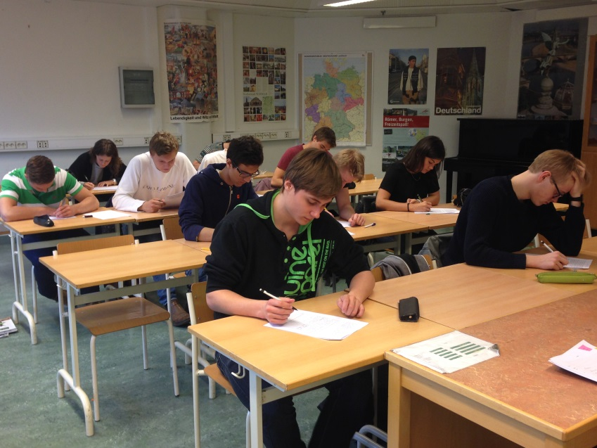
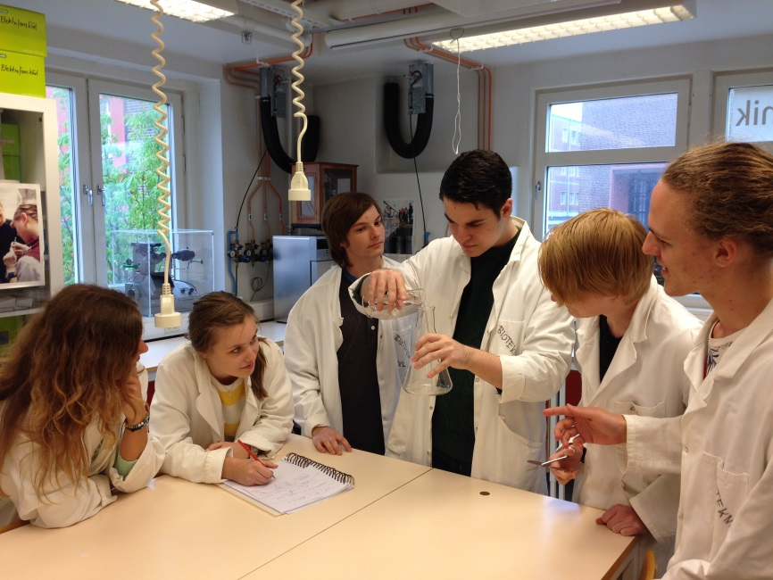
The number of students is around 1100 and teaching staff about 60. The students can choose between four different national programmes: economics, natural sciences, social sciences and technology with industrial design.
Our students are very well motivated. Each programme has relatively high admission credits. Problems concerning drop outs, students who do not complete their studies, are rather rare.

Slide 4
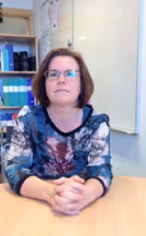
We also have a health team that consists of headmasters, two school nurses, a social worker and a remedial teacher.

Slide 5
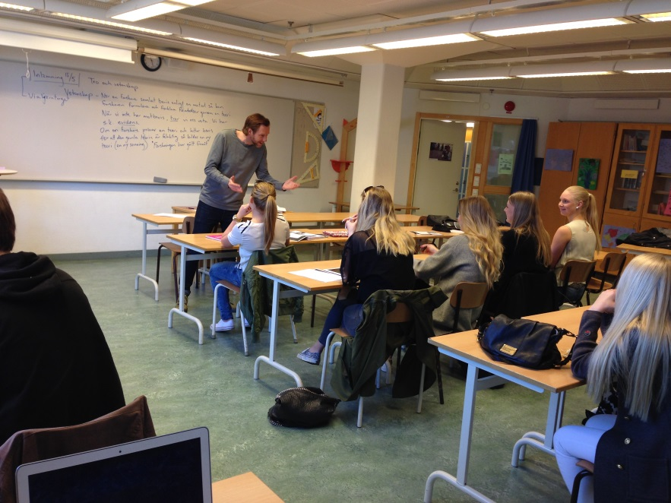
The mentors of each class are not to be forgotten. They are a very important part of the wellbeing. Once per semester, the mentors invite the students together with their parents to individual discussions about the students wellbeing and school situation in general.
And every week the mentors have “the mentor´s half hour” together with the class to summarize what has happened and what is to be done.

Slide 6
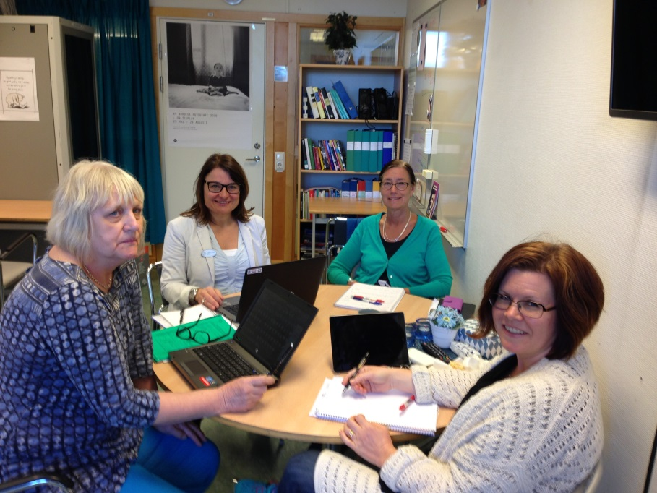
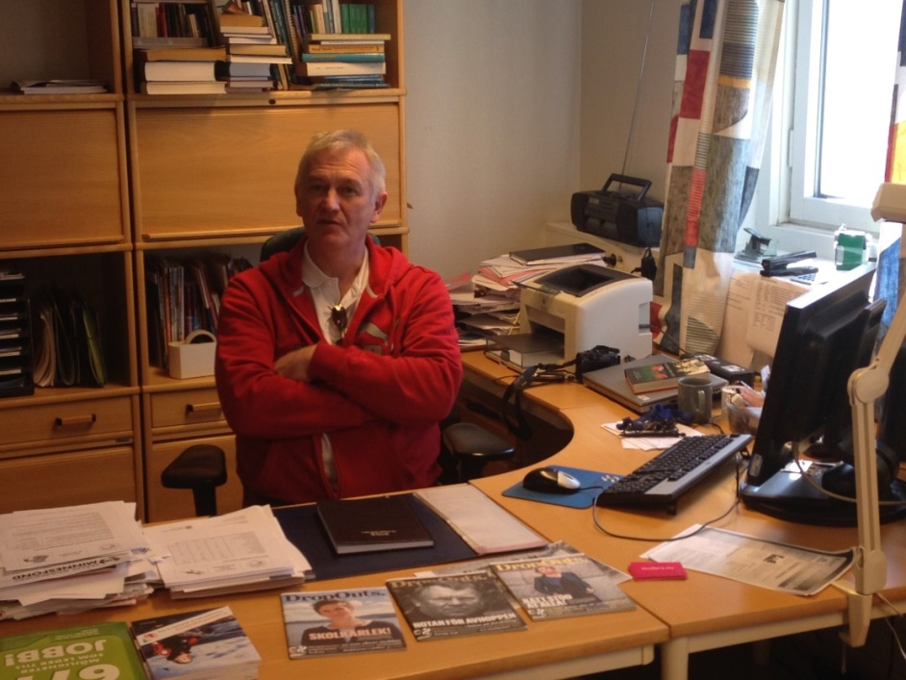
If a student for some reason or another chooses to leave school, then the educational adviser is supposed to advice and help the student to find alternative solutions. No student is allowed to quit school without consulting the educational adviser. The School will always try to find an adequate solution for the student.
Health team meeting
Leif Kjellgren, educational adviser

